Slide 1
Baremetal programming

Slide 2
Agenda
Microcontroller vs Microprocessor and SoC Architectures
Firmware vs Embedded Software
GPIO interface
I2C (Inter - Integrated Circuit) Protocol
SPI Protocol
UART Protocol
General C vs Embedded C
Software and Hardware tools to work on STM32 Microcontroller/Baremetal driver development programming
Introduction to STM32CubeIDE, Eclipse & Keil IDEs
Embedded C Start-up Code
C Program debugging in Eclipse based IDE
Understanding of ARM Cortex – M4 architecture
Understanding of STM32 Microcontroller
GPIO Bare metal Programming: LED & Switches

Slide 3
Microcontroller vs Microprocessor and SoC Architectures

Slide 4
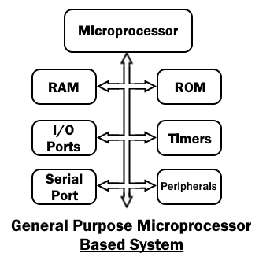
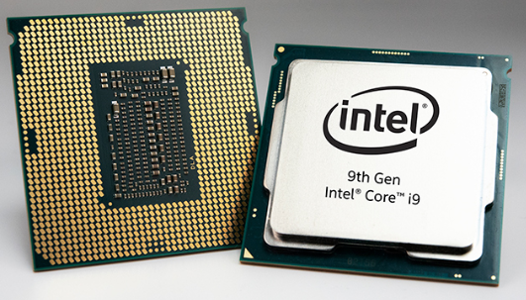
Microprocessor
A microprocessor is an IC that has only CPU (Central processing unit) without other necessary components inside the (IC) packaging. Its packaging does not contain RAM, ROM and other components required to perform a task. That is why it needs external components to complete a task.
Due to this reason, the devices made from microprocessors are bulkier and power consuming but they have up-gradable memory and high processing capacity for performing complex tasks such as games, website and software development, etc… its functions are unlimited.

Slide 5
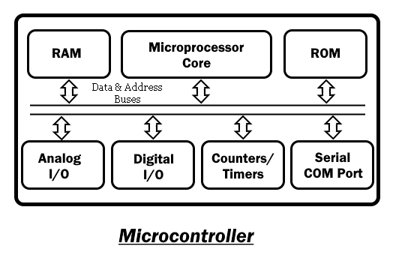
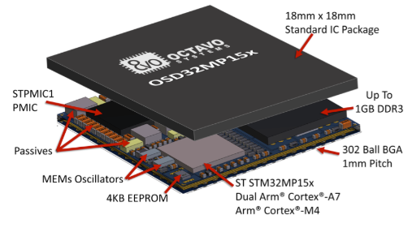
Microcontroller
A microcontroller is a mini-computer on a single semiconductor IC (integrated circuit) chip. It is a complete computer and has all the essential components needed on a single chip such as the processing unit, ROM, RAM, I/O ports, serial ports and Timers, etc.
It does not need external components to perform a task which makes it a perfect candidate for embedded and compact devices in industries.

Slide 6
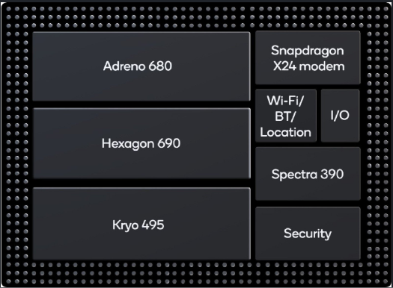
SOC (System On chip)
An SoC integrates a microcontroller or microprocessor with advanced peripherals like graphics processing unit (GPU), Wi-Fi module, or one or more coprocessors.

Slide 7
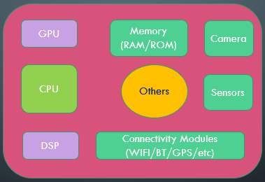
Microprocessor, Microcontroller and SoC Overview
Microprocessor
Processor Core
System Bus
System Bus
Clock
RAM
Storage
Clock
RAM
Storage
Peripheral Bus
Peripheral Bus
I2C/SPI/USB
Ethernet
MMC
I2C/SPI/USB
Ethernet
MMC
Microprocessor
Microcontroller
SoC

Slide 8






Differences between Microprocessor and Microcontroller
Parameters | Microprocessor | Microcontroller
Applications | General computing(Laptop/Desktop), Gaming, web browsing, document creation etc. | Dedicated for specific tasks (Camera, washing machine etc.)
Internal Structure | Memory and I/O devices connected externally to the CPU | CPU, memory and I/O are present internally
Cost | High | Low
Power Consumption | High | Low
Memory (RAM) | 512 MB to up to 32 GB | 2KB to up to 256 KB
Internal Storage | Hard Disk (128 GB up to 2 TB) | Flash memory (32 KB to 2 MB)
Peripheral Interfaces | USB, UART, High speed Ethernet | UART, I2C, SPI
Size of registers, Address and Data bus | 32 bit or 64 bit | 8 bit, 16 bit or 32 bit
Vendors

Slide 9
Firmware vs Embedded software

Slide 10
Firmware/Baremetal:
The term “firmware” refers to the software which is stored in the special type of read-only memory such as EPROM (erasable programmable read-only memory), or an EEPROM, the “electrically erasable” where the stored software is “firm” which needs special technique to erase or update the software.
Firmware is typically used as low-level software that operates a specific, single-purpose device like TV, washing machine, A/C, remote, etc.
In olden days, firmware was very difficult to update but now it got very simple
Also there were very less space to store the software but now flash memory is being used to store big software.
There is no OS involves in firmware so it is called baremetal.
Embedded Software:
The program files for embedded software reside in the device’s file system until called upon to execute, at which point the executable code is loaded into the device’s random access memory (RAM) and executed by the microprocessor. Embedded software typically implements higher-level features and functions of the device.
Embedded software can be highly sophisticated, and is often written in high-level languages such as C++, Java, JavaScript, or Python. Many modern devices are there with an operating system involved, such as Android or Linux.

Slide 11
Protocols

Slide 12
Protocol | Type | Max Speed (bps) | Max distance(ft.) | Usage
Ethernet | Serial | 10G | 1600 | Network Communications
USB 3.0 | dual simplex serial | 5G | 9 | Mass Storage, Video
USB 2.0 | half duplex serial | 1.5M, 12M, 480M | 16 | Keyboard, Mouse, drive, camera, printers, speakers
RS-485 | asynchronous serial | 10M | 4000 | Data Acquisitions and control Systems
I2C | Synchronous serial | 3.4M in High speed mode | 18 | Microcontroller communications
RS-232 | asynchronous serial | 20k | 50-100 | Modem, Mouse, Instrumentation
SPI | Synchronous serial | fPCLK/2 | 10 | sensors, display, serial flash

Slide 13
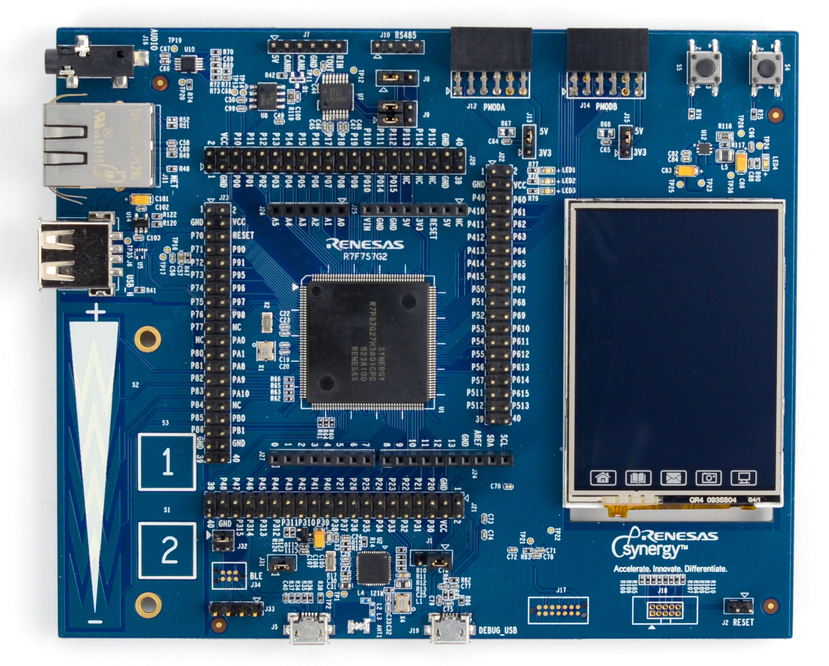
EEPROM
Sensors
SPI/I2C
SPI
SPI
MCU
Display
SPI
Flash

Slide 14
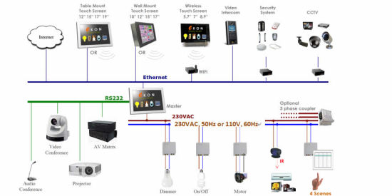
To cover larger area of distance for communication we can use CAN, ethernet, RS485, etc protocols.

Slide 15
GPIO (General purpose input-output)

Slide 16
General Purpose Input Output (GPIO)
GPIO pins most commonly used in toggling LED’s and handling press and release events of the buttons.
But, GPIO’s are not limited to only this applications.
GPIO’s are used in many other applications.

Slide 17
General Purpose Input Output (GPIO)
Applications of GPIO:
Reading/Writing digital signal
Issuing interrupts
Generating triggers for the external components
Waking up the processor
MCU
Enable Line
Pin
Output buffer
Input buffer
GPIO Pin
Notes:
Self Created

Slide 18
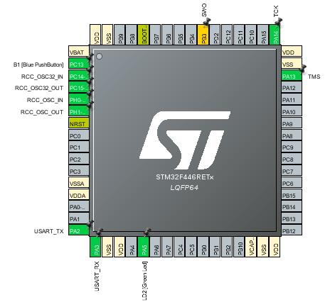
General Purpose Input Output (GPIO)
GPIO Port and Pin:
GPIO port is a collection of fixed number of I/O pins (i.e., in STM32 Nucleo board there are 16 pins in each port)
Each pin represented by the corresponding bit of the GPIO port registers
PA 8 | PA 9 | PA 10 | PA 11 | PA12 | PA13 | PA14 | PA15
GPIO Port A
PA 0 | PA 1 | PA 2 | PA3 | PA4 | PA5 | PA6 | PA7
Notes:
Self created
Taken from STM32CubeMX IDE tool

Slide 19
GPIO Input & Output Mode
+VCC
+VCC
T1
Source
Source
T1
gate
gate
PMOS
PMOS
Pin
Pin
Drain
Drain
gate
NMOS
NMOS
T2
gate
Source
T2
Source
GND
GND
Output Buffer
Input Buffer
Notes:
Self Created

Slide 20
GPIO Pin Hi-Z State
+VCC
Hi-Z state
By default all the GPIO pins are in floating (Hi-Z) state
It results in current leakage
T1
Source
gate
PMOS
Pin
Hi-Z state
Drain
NMOS
gate
T2
Source
GND
Input Buffer
Notes:
Self Created

Slide 21
GPIO Input Mode with
Internal Pull-Up/Pull-Down
To avoid Hi-Z state internal pull-up/pull-down registers will be activated in GPIO input mode
+Vcc
Pin
Ri
Ri
Pin
GND
Input Buffer with Pull-up Register
Input Buffer with Pull-down Register
Notes:
Self Created

Slide 22
GPIO Output Mode with
Open-Drain State
+VCC
In open-drain state PMOS transistor will be turned off.
So, output state can be either GND or floating
T1
Source
gate
PMOS
Drain
Pin
gate
NMOS
T2
Source
GND
Notes:
Self Created

Slide 23
GPIO Output Mode with
Open-Drain Pull-up
+VCC
+VCC
Ri
Re
Pin
Pin
gate
NMOS
NMOS
gate
T2
T2
Source
Source
GND
GND
Open-drain with internal pull-up
Open-drain with external pull-up
Notes:
Self Created

Slide 24
GPIO Output Mode with Push-pull Configurations
By default GPIO output mode is in push-pull configurations
Here, no need of any internal/external pull-up/pull-down registers.
Output will be pulled active low/high using these transistors
+VCC
T1
Source
gate
PMOS
Pin
Drain
gate
NMOS
T2
Source
GND
Output Buffer
Notes:
Self Created

Slide 25
I2C ( I ‘squareD’ C ) protocol

Slide 26
I2C needs just 2 pins to connect all the master and slave devices to it
+VCC
R1
R2
Pull-up registers
SDA
SCL
Master-1
Master-2
Slave-1
Slave-2
Slave-3
Both SDA and SCL lines are bi-directional lines connected to positive power supply (+VCC) via pull-up registers. When the bus is free both the lines are pulled HIGH.
The output stages of the devices connected to the bus must have open-drain or
open-collector configurations. Means, if you are using GPIO pins for I2C then it needs to be configured as open-drain or open-collector.

Slide 27
I2C Modes
Mode | Data Rate
Standard Mode | Up to 100 kbps
Fast Mode | Up to 400 kbps
Fast Mode+ | Up to 1 Mbps
High Speed Mode | Up to 3.4 Mbps
Standard mode devices are not upward compatible; they cannot communicate with the devices of fast mode or above.
Fast mode devices are downward-compatible and can communicate with standard mode devices in I2C-bus system.
Fast mode devices are not upward compatible; they cannot communicate with the devices of fast mode+ or above.

Slide 28
I2C Protocol
R/W = 1 indicates master wants to read/receive the data from the slave
R/W = 0 indicates master wants to write/transmit the data to the slave
S
A7
A6
A5
A4
A3
A2
A1
R/W
ACK
D7
D6
D5
D4
D3
D2
D1
D0
ACK
P
Stop bit
Start Condition
7 or10 – bit Address of the slave device
Read/Write bit
Data Acknowledge bit
Address matching Slave acknowledges
Every byte put on SDA line must be 8-bit long
Each byte must be followed by an acknowledgement bit
Data is transferred with the MSB first

Slide 29
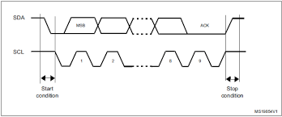
I2C START and STOP conditions
A HIGH to LOW transition on the SDA line while SCL is HIGH defines a START condition.
A LOW to HIGH transition on the SDA line while SCL is HIGH defines a STOP condition.
After bus is released both the SDA and SCL lines stays HIGH

Slide 30
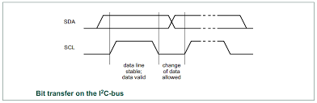
Data Validity:
The data on the SDA line must be stable during the SCL is HIGH.
The HIGH or LOW state of the data line can only change when the clock signal on the SCL line is LOW. One clock pulse is generated for each data bit is transferred.

Slide 31
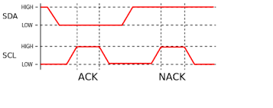
ACK and NACK conditions
ACK means SDA line is pulled to HIGH while SCL is HIGH.
NACK means SDA line is pulled to HIGH while SCL is HIGH.
When master receives NACK then either it abnormally terminates the transaction by generating STOP condition or generates repeated START condition to start a new transfer.
The acknowledgement takes place after every byte.

Slide 32
Conditions that lead to the generation of a NACK:
The receiver is unable to receive or transmit because it is performing some real-time function and is not ready to start communication with the master.
During the transfer, the receiver gets data or commands that it does not understand.
During the transfer, the receiver cannot receive any more data bytes.
A master-receiver is done reading data and indicates this to the slave through a NACK.

Slide 33
Remember….
The master generates all the clock pulses.
START and STOP conditions are always generated by the master.
The bus is considered to be busy after the START condition.
The bus is considered to be free after the STOP condition.
When the bus is free another master(if any) can get the chance to claim the bus.
The bus stays busy if a repeated START is generated without STOP condition.
Most of the MCU’s I2C peripherals supports both master or slave modes.
We no need to configure the mode because when the device generates the START condition it automatically becomes master and when it generates the STOP condition it goes back to the slave mode.

Slide 34
Remember….
Clock-stretching :
When slave is busy in receiving data it will pull the SCL line to LOW so that master cannot send the data
Bus arbitration:
It may happen that two masters start a transfer at the same time. During the transfer, the masters constantly monitor SDA and SCL. If one of them detects that SDA is low when it should actually be high, it assumes that another master is active and immediately stops its transfer. This process is called arbitration.

Slide 35
SPI(Serial Peripheral Interface) protocol

Slide 36
SPI Bus
Master
MCU
Serial Clock
SCLK
SCLK
Master Out Slave In
Slave
(Sensors, EEPROM, SDCARD, Display, Wifi, BT, etc)
MOSI
MOSI
Master In Slave Out
MISO
MISO
gpio1
Slave Select
SS
SPI bus allows communication b/w one master and one or multiple slave devices

Slide 37
SPI Bus
Master
MCU
Serial Clock
SCLK
SCLK
Master Out Slave In
Slave
(Sensors, EEPROM, SDCARD, Display, Wifi, BT, etc)
MOSI
MOSI
Master In Slave Out
MISO
MISO
gpio1
Slave Select
SS
There are 4 I/O pins dedicated to SPI communication with the external devices.
MISO: This pin is used to transmit date in slave mode and receive data in master mode.
MOSI: This pin is used to transmit date in master mode and receive data in slave mode.
SCLK: Serial clock output pin for SPI master and input pin SPI slaves.
SS/NSS/CS (Slave Select/Chip Select): This pin is used to select a particular slave device for communication

Slide 38
Master
MCU
Serial Clock
SCLK
SCLK
Master Out Slave In
Slave
(Sensors, EEPROM, SDCARD, Display, Wifi, BT, etc)
MOSI
MOSI
Master In Slave Out
MISO
MISO
gpio1
Slave Select
SS
Slave has to support for SPI communication.
Master uses one of its GPIO pin to pull the SS line to the ground to communicate with a particular slave device.

Slide 39
Minimal SPI communication:
When there is only one master and one slave then there is a possibility of reducing the lines for communication in SPI based on application design.
Master
MCU
Serial Clock
SCLK
SCLK
Master Out Slave In
Slave
(Sensors, EEPROM, SDCARD, Display, Wifi, BT, etc)
MOSI
MOSI
MISO
MISO
gpio1
SS

Slide 40
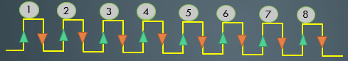
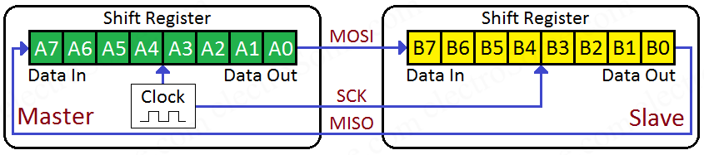
SPI Hardware
Data shift out direction ( MSB bit shift first or LSB bit shift first ) is depends on application configurations.

Slide 41
Customizing SPI Bus Configurations:
SPI bus can be configured in different modes based on target slave device and application requirements.
SPI full-duplex communication:
SCLK
Clock
SCLK
SCLK
MISO
Up to 16-bit shift registers
MISO
MISO
Up to 16-bit shift registers
MOSI
MOSI
MOSI
NSS
NSS
NSS

Slide 42
SPI half-duplex communication:
SCLK
Clock
SCLK
SCLK
MISO
Up to 16-bit shift registers
MISO
MISO
Up to 16-bit shift registers
R
MOSI
MOSI
MOSI
NSS
NSS
NSS
SPI Simplex communication:
SCLK
Clock
SCLK
SCLK
MISO
Up to 16-bit shift registers
MISO
MISO
Up to 16-bit shift registers
MOSI
MOSI
MOSI
NSS
NSS
NSS

Slide 43
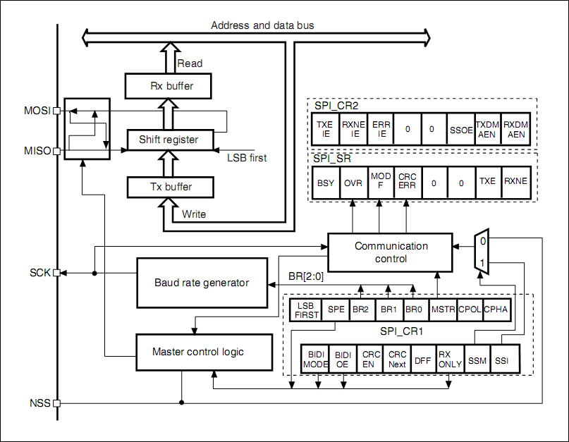
SPI Block Diagram

Slide 44
SPI Communication Format
SCLK PHASE (CPHA)
SCLK POLARITY (CPOL)
Data frame format (DFF)
During SPI communication, data receive and transmit operations performed simultaneously.
The serial clock (SCLK) synchronizes the shifting and sampling of the information on the data lines.
The communication format depends on the clock phase, clock polarity and the data frame format (8-bit or 16-bit).
Note: Master and slave needs to follow the same communication format to communicate.

Slide 45
CPOL (Clock polarity):
The CPOL bit controls the idle state value of the clock when there is no data being transferred.
If CPOL bit is set, the SCLK pin has a high-level idle state.
If CPOL bit is reset, the SCLK pin has a low-level idle state
CPOL = 1
CPOL = 0

Slide 46
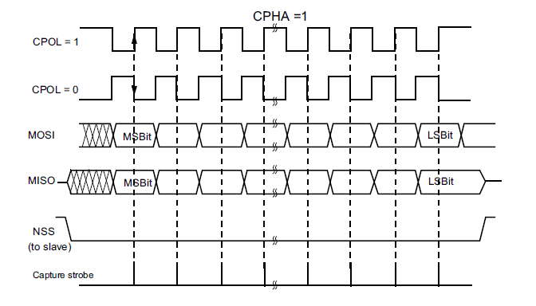
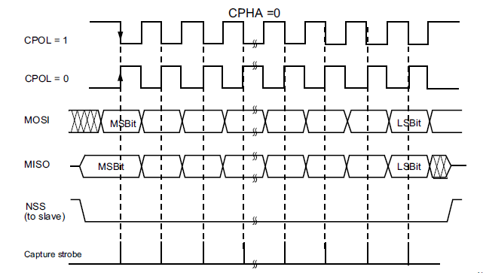
CPHA (Clock pHASE):
The CPHA bit controls at which clock edge of the SCLK(1st or 2nd) the data should be sampled by the slave.
The combination of the CPOL and CPHA bits selects the data capture clock edge.
Data will appear on the lines during 1st edge of the clock and capture happens at 2nd edge of the clock.
Data will appear on the lines during 2nd edge of the clock and capture happens at 1st edge of the clock.

Slide 47
Differences b/w I2C and SPI
I2C allows to communication for longer distance compared to SPI
I2C needs only 2 wires for communication where as SPI needs 4 wires. So, SPI is costlier than I2C.
I2C have ACK facility to confirm on data transmitted successfully or not but SPI doesn’t have.
I2C slaves are identified by addresses where as SPI doesn’t have any addresses for its slaves so it needs extra wire for it.
I2C have clock stretching feature to avoid data loss but SPI don’t have any such features.
I2C is multi-master multi-slave communication protocol as per its specification but in SPI specification it is not a multi-master protocol but software side it can be implemented.
I2C have bus-arbitration hardware which decides on bus control given to which master if there is a race in communication.
SPI allows faster communication compared to I2C
SPI is a full-duplex communication protocol where as I2C half-duplex.

Slide 48
UART(Universal asynchronous receiver-transmitter) protocol

Slide 49
Uart VS usart
Universal
Asynchronous
Receiver
Transmitter
Universal
Synchronous
Asynchronous
Receiver
Transmitter
UART/USART converts parallel data into serial.
UART peripheral supports only asynchronous mode.
USART peripheral supports both synchronous and asynchronous mode.
There is no specific port for USART communication. They are commonly used in conjunction with protocols like RS-232, RS-434,USB, etc.
In case of USART for synchronous communication, the clock is sent separately from the data stream and no start/stop bits are used.

Slide 50
USART Hardware Components
Baud rate generator
Tx and Rx shift registers
Transmit/Receive control blocks
Transmit/Receive buffers
First-in, First-out (FIFO) buffer memory

Slide 51
In UART, minimum of 2 pins will be used for communication.
Tx
Tx
Transmitter
Rx
Rx
Receiver
RTS
RTS
Request To Send
CTS
CTS
Clear To Send
Make RTS low, CTS also goes low

Slide 52
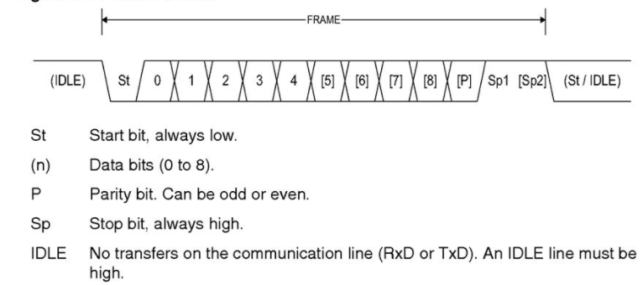
UART Frame Format
A frame refers to the entire data packet which is being sent or received during the communication.
The baud rate is a measure of the number of bits per second that can be transmitted or received by the UART.
If you invert the baud rate, you can find out, how long it takes to transmit a single bit.

Slide 53
Common baud rates are:
2400, 4800, 9600, 19200, 38400, 57600 and 115200
Ex: Baud rate = 115200 then
to transmit single bit it takes 1/115200 = 8.6 micro sec.
Both the transmitting and receiving devices should operate at the same baud rate.
START and STOP bits are used for synchronization bits in UART
PARITY (even or odd) bit is used for error detection during transmission.

Slide 54
General C vs Embedded C

Slide 55
Basic differences
More or less generic C and embedded C both are same.
Embedded C is the extension of generic C.
Application point of view embedded C is used in microcontrollers like TV, washing machines etc. where as C finds applications in OS based systems.
C directly run program from OS terminal whereas embedded C needs to create the file first then download to the embedded system where the compiling process is carried out
Generic C needs underlying OS to run but embedded C doesn’t need OS to run.
Embedded C has limited source constraints like limited RAM/ROM etc. whereas C can make use of all computer resources.
Embedded C programs cannot take user inputs but C can take.
Extra features are added in Embedded C like I/O register mapping or operation, number of memory areas, and fixed point representation.
Embedded C performs only one task at one time mean it purposed the dedicated task

Slide 56
Software and Hardware

Slide 57
HARDWARE
No | Item | Nos | Note | Reference link
1 | STM32F446RE NUCLEO board | 1 | This is the main development board for which drivers are developed. | check here
2 | Arduino uno | 1 | The Arduino uno board is used to test SPI,I2C,UART code examples . This board acts as a slave device and communicates with the main STM32 board. | check here
3 | LEDs | 1 | 5mm LED | check here
4 | Push button | 1 | Mini Pushbutton Switch | check here
5 | Resistors | 1 | 22KΩ, 4.7KΩ, 470Ω ; 1 each
6 | USB logic analyzer | 1 | In this course saleae logic 8 device is used. Please check www.saleae.com for more information about the different products available from saleae | check here
7 | Jumper wires | 15 | M-M, M-F,F-F; 5 each | check here
8 | Breadboard | 1 | full or medium size | check here
Software/Documents
https://www.st.com/en/evaluation-tools/nucleo-f446re.html https://www.st.com/en/microcontrollers-microprocessors/stm32f446re.html https://developer.arm.com/docs/100166/0001 http://infocenter.arm.com/help/topic/com.arm.doc.dui0553b/DUI0553.pdf

Slide 58
Introduction to STM32CubeIDE, Eclipse AND Keil IDE’s

Slide 59
Links to Download
https://www.st.com/en/development-tools/stm32cubeide.html#overview
https://www.keil.com/
https://www.st.com/en/development-tools/sw4stm32.html
https://www.openstm32.org/Downloading%2Bthe%2BSystem%2BWorkbench%2Bfor%2BSTM32%2Binstaller

Slide 60
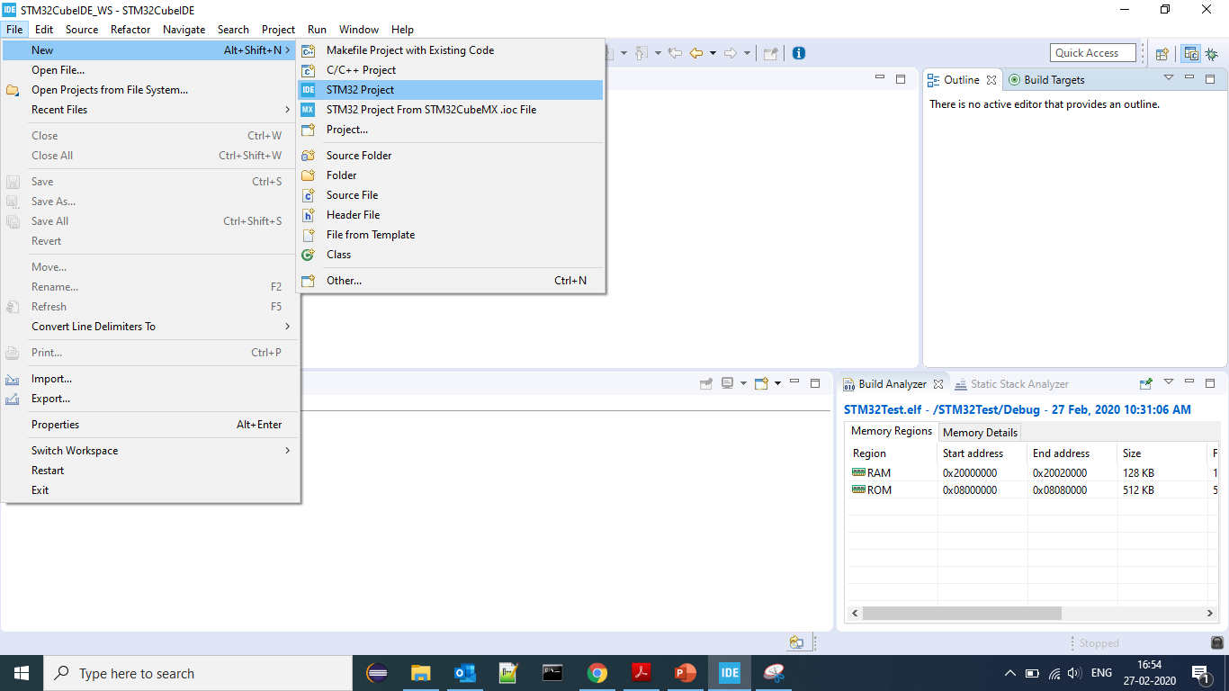

Slide 61
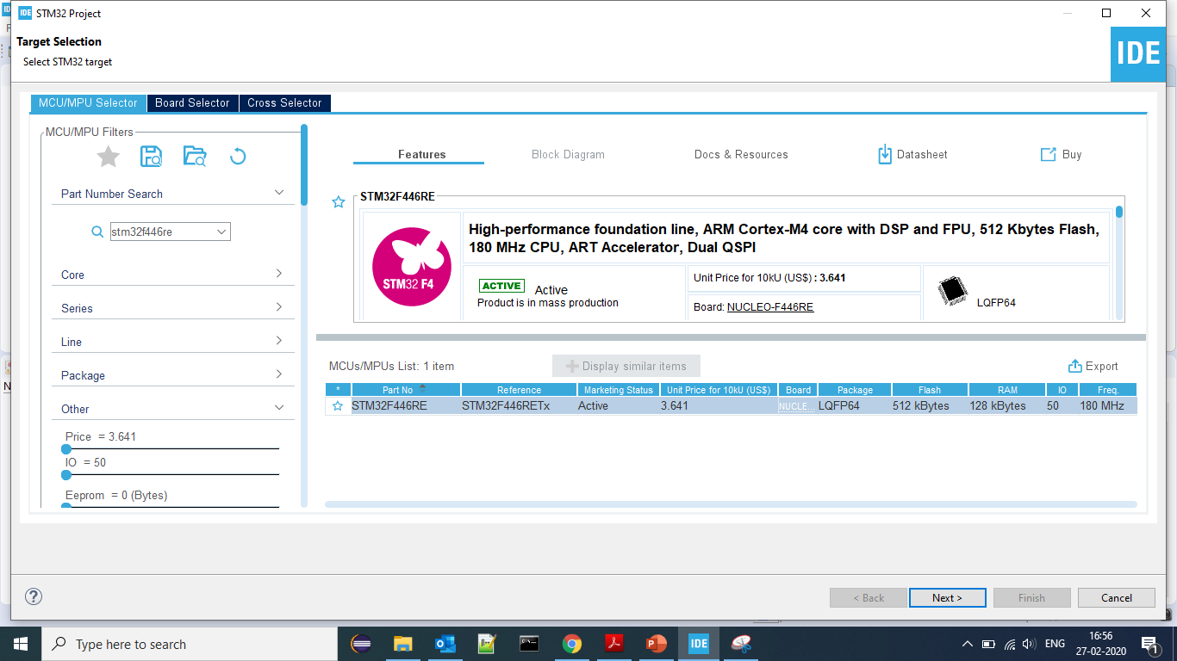

Slide 62
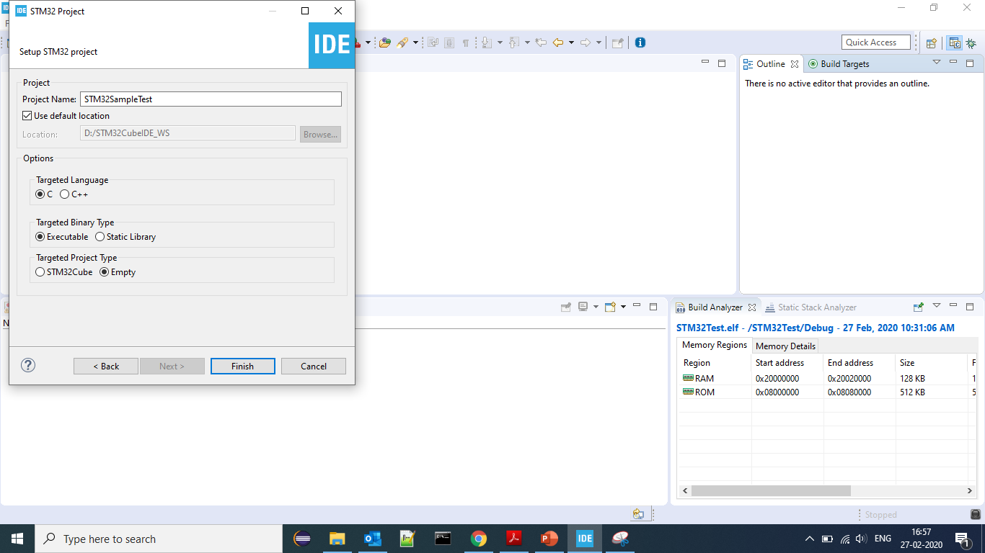

Slide 63
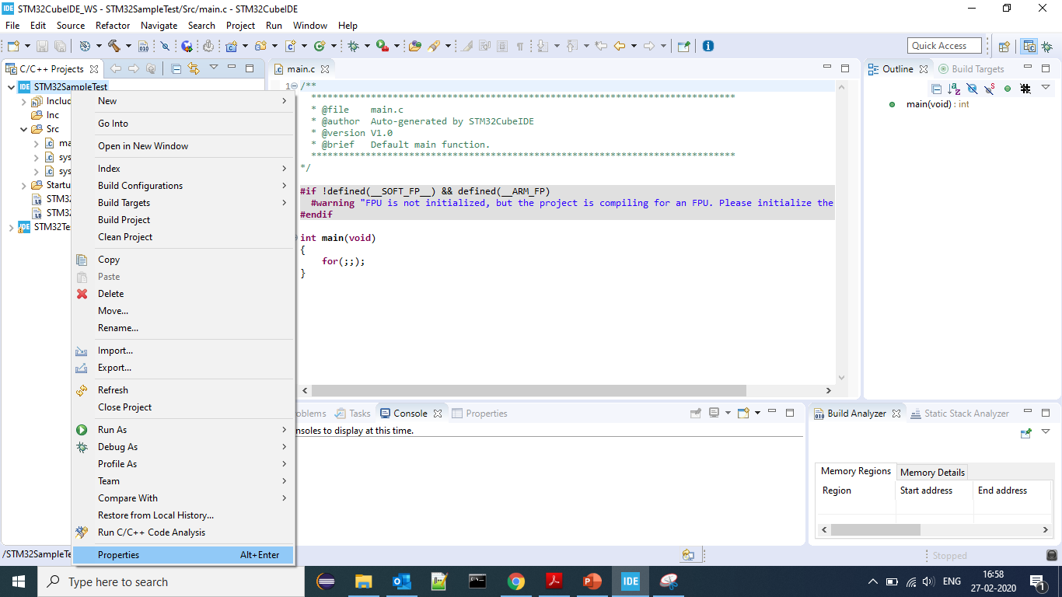
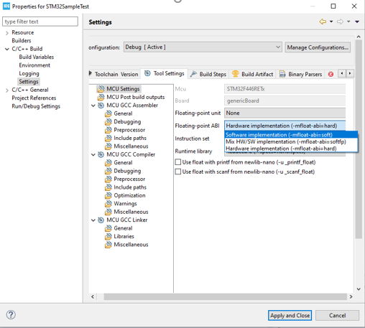

Slide 64
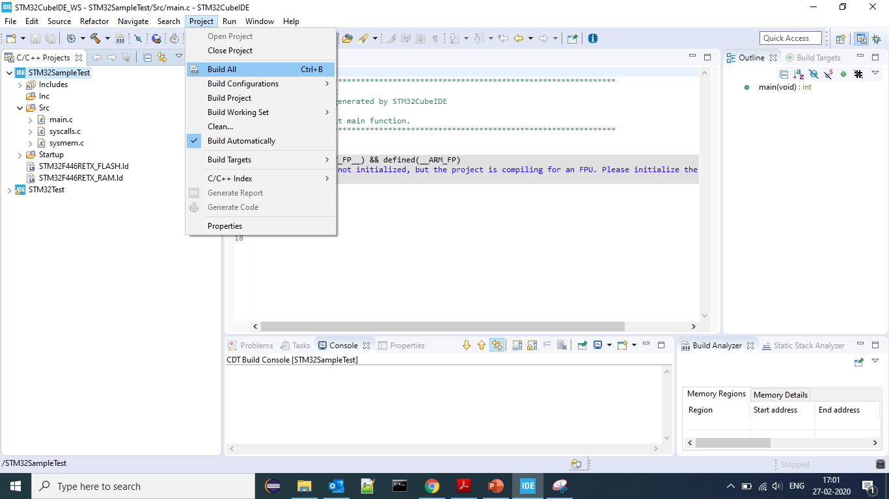

Slide 65
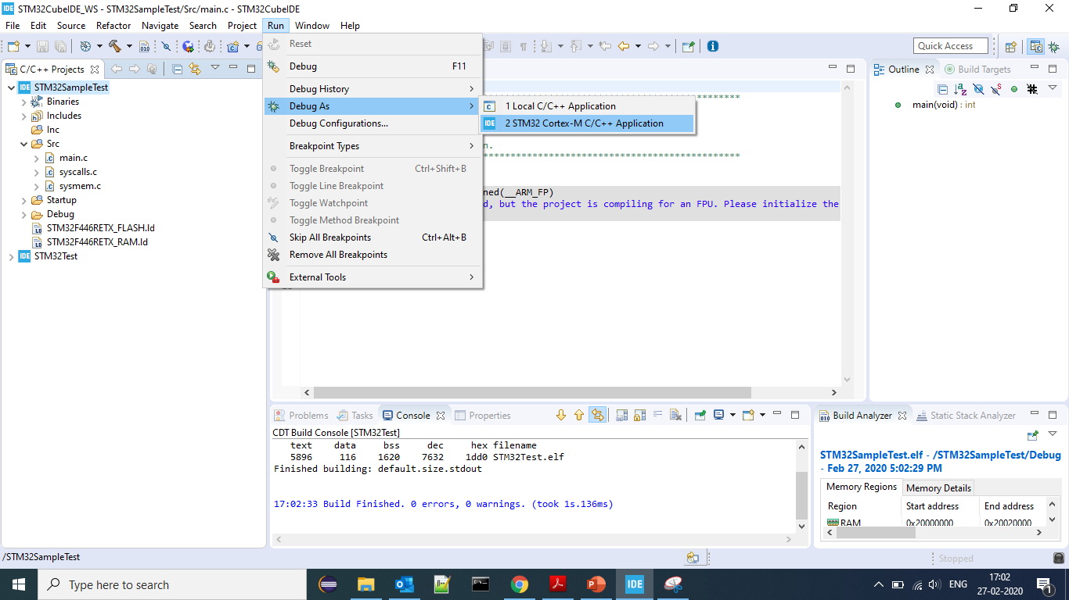

Slide 66
ARM Cortex-M4 Architecture

Slide 67
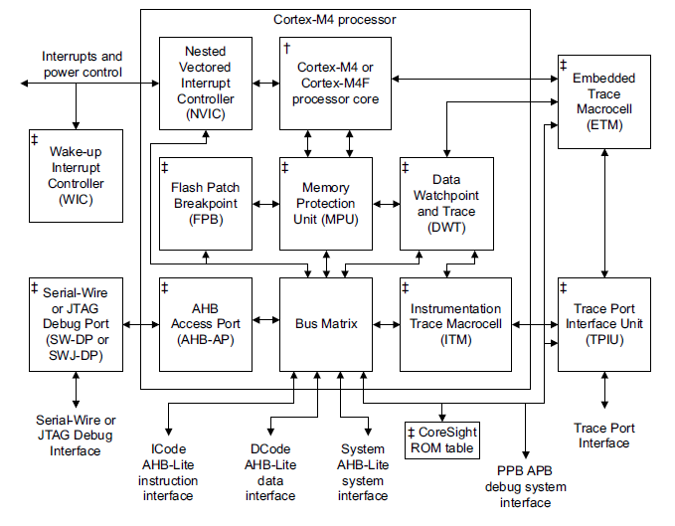
Cortex-M4 Block Diagram

Slide 68
The Cortex-M4 processor is a high performance 32-bit processor designed for the
microcontroller market.
It offers significant benefits to developers, including:
• outstanding processing performance combined with fast interrupt handling
• enhanced system debug with extensive breakpoint and trace capabilities
• efficient processor core, system and memories
• ultra-low power consumption with integrated sleep mode and an optional
deep sleep mode
• platform security robustness, with optional integrated Memory Protection Unit
(MPU).

Slide 69
Features of ARM Cortex-M4 Microcontroller:
3–stage pipeline
Harvard architecture
Thumb instruction set based on Thumb-2 technology, ensuring high code density and reduced program memory requirements
Hardware integer divide instructions, SDIV and UDIV
Processor Modes:
Thread mode
Handler mode
Automatic processor state saving and restoration for low latency Interrupt Service Routine (ISR) entry and exit.
States:
Thumb state
Debug state
Register
R0-R12
Banked stack pointer (SP_thread and SP_main)
R14, R15, xPSR
Support for ARMv6 big-endian byte-invariant or little-endian accesses
Support for ARMv6 unaligned accesses
Optional Floating Point Unit (FPU) to do floating point operations
Optional Memory Protection Unit (MPU)

Slide 70
Nested Vectored Interrupt Controller (NVIC) closely integrated with the processor core to achieve low-latency interrupt processing.
Features include:
External interrupts, configurable from 1 to 240.
Bits of priority, configurable from 3 to 8.
Dynamic reprioritization of interrupts.
Priority grouping. This enables selection of preempting interrupt levels and non pre-empting interrupt levels.
Support for tail-chaining and late arrival of interrupts. This enables back-to-back interrupt processing without the overhead of state saving and restoration between interrupts.
Processor state automatically saved on interrupt entry, and restored on interrupt exit, with no instruction overhead.
Optional Wake-up Interrupt Controller (WIC), providing ultra-low-power sleep mode support.
Bus interfaces:
Three Advanced High-performance Bus-Lite (AHB-Lite) interfaces: ICode, DCode, and System bus interfaces.
Private Peripheral Bus (PPB) based on Advanced Peripheral Bus (APB) interface.
Bit-band support that includes atomic bit-band write and read operations.
Memory access alignment.
Write buffer for buffering of write data.
Exclusive access transfers for multiprocessor systems.

Slide 71
Low-cost debug solution that features:
Debug access to all memory and registers in the system, including access to memory-mapped devices, access to internal core registers when the core is halted, and access to debug control registers even while SYSRESETn is asserted.
Serial Wire Debug Port (SW-DP) or Serial Wire JTAG Debug Port (SWJ-DP) debug access.
Optional Flash Patch and Breakpoint (FPB) unit for implementing breakpoints and code patches.
Optional Data Watchpoint and Trace (DWT) unit for implementing watchpoints, data tracing, and system profiling.
Optional Instrumentation Trace Macrocell (ITM) for support of printf() style debugging.
Optional Trace Port Interface Unit (TPIU) for bridging to a Trace Port Analyzer (TPA), including Single Wire Output (SWO) mode.
Optional Embedded Trace Macrocell (ETM) for instruction trace.

Slide 72
STM32 Microcontroller

Slide 73
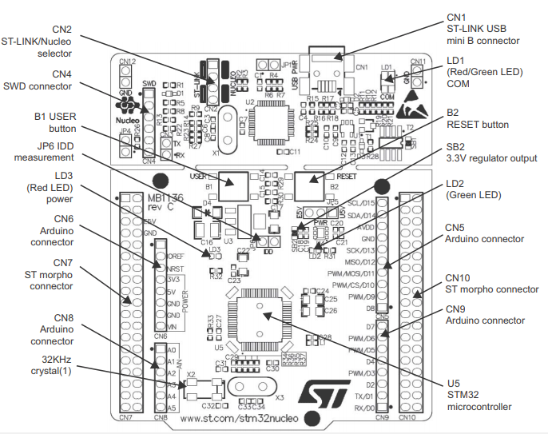
STM32F446RE (Nucleo Board) Design Layout

Slide 74
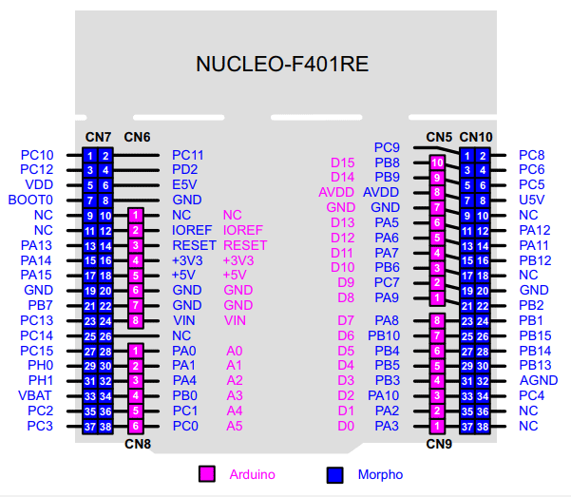
PIN CONFIGURATIONS

Slide 75
Peripheral clock configurations
By default, peripheral clocks of all most all the peripherals are disabled to save power.
In modern MCU’s, before using any peripherals we must need to enable its peripheral clock using peripheral clock registers
A peripheral will not accept or respond to your configuration values until you enable its peripheral clock
In STM32 microcontrollers, peripheral clocks are managed through RCC registers.
Types of clocks are:
External clocks
• HSE oscillator clock (Crystal oscillator)
Internal clocks
• HSI oscillator clock (RC oscillator)
• Two main PLL (PLL) clocks (Phase Locked Loop Internal clocks. i.e., PLLCLK & PLLR)
Source of clocks are:
HSI
HSE
PLL

Slide 76
GPIO pins Interrupt Delivery to the Processor
MCU Peripheral Side
Processor Side
GPIO Port is identified by SYSCFG_EXTICR register configuration
6
7
8
9
10
23
40
EXTI0
Processor Core
GPIOx_PIN0
EXTI1
GPIOx_PIN1
EXTI2
NVIC
GPIOx_PIN2
GPIOx_PIN3
EXTI
EXTI3
GPIOx_PIN4
EXTI4
GPIOx_PIN5_9
EXTI5_9
GPIOx_PIN10_15
EXTI10_15
EXTI block does Edge detection(FT,RT).
Enable/Disable of interrupt delivery to the processor
Enable/Disable of IRQs are configured in NVIC registers

Slide 77
Gpio pin Interrupt configurations:
Pin must be configured in INPUT mode
Configure the edge trigger (RT,FT,RFT)
Enable Interrupt delivery from Peripheral to the Processor (On Peripheral side)
Identify the IRQ number on which the processor accepts the interrupt from that pin
Configure the IRQ priority for the identified IRQ number (Processor Side)
Enable Interrupt reception on that IRQ number (Processor Side)
Implement IRQ handler.

Slide 78
General Purpose Input Output
Applications of GPIO:
Reading digital signal
Issuing interrupts
Generating triggers for the external components
Waking up the processor
GPIO Port and Pin:
GPIO port is a collection of fixed number of I/O pins (i.e., in STM32 Nucleo board there are 16 pins in each port)
Each pin represents corresponding bit of the GPIO port registers

Slide 79
GPIO PIN CONFIGURATIONS
GPIO Pin
Input
Output
Alt. Func
Analog
Interrupt Mode
In input mode, GPIO pin can be configured to issue an interrupt to the processor

Slide 80
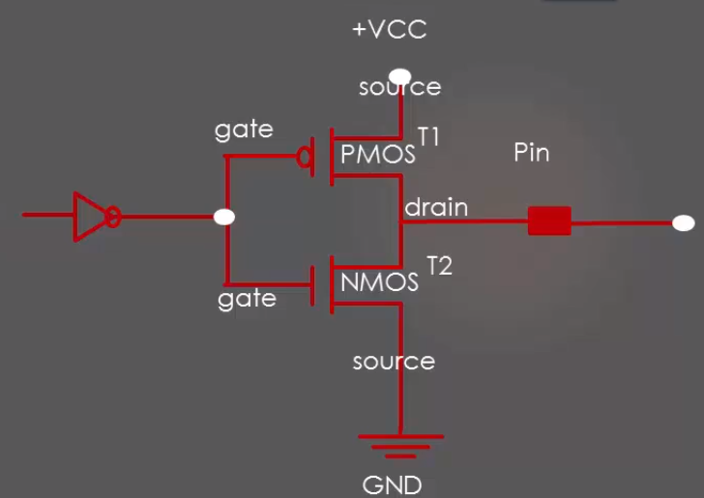
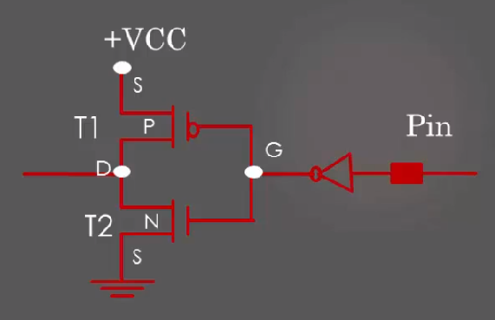
Based on enable line GPIO have two buffers:
When enable line = 0 then output buffer will be activated
When enable line = 1 then input buffer will be activated
Output buffer
Input buffer

Slide 81
GPIO registers:
GPIO port mode register (GPIOx_MODER)
GPIO port output type register (GPIOx_OTYPER)
GPIO port output speed register (GPIOx_OSPEEDR)
GPIO port pull-up/pull-down register (GPIOx_PUPDR)
GPIO port input data register (GPIOx_IDR)
GPIO port output data register (GPIOx_ODR)
GPIO port bit set/reset register (GPIOx_BSRR)
GPIO alternate function low register (GPIOx_AFRL)
GPIO alternate function high register (GPIOx_AFRH)

Slide 82
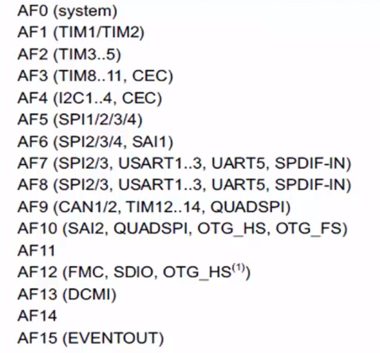
GPIO pins alternate functionalities:

Slide 83
Baremetal/Firmware Applications
Firmware driver Layer
gpio_driver.h & .c
spi_driver.h & .c
(Device header file)
stm32f446re.h
i2c_driver.h & .c
uart_driver.h & .c
STM32F446RE MCU
GPIO
I2C
SPI
UART

Slide 84
What needs to be included in device header file:
This header file needs to contain all the MCU specific details such as:
The base addresses of all the memories present on the microcontroller (like SRAM1,SRAM2,FLASH, etc)
The base addresses of various buses (like AHB1,AHB2,APB1,APB2,etc)
Base addresses of various peripherals present on the buses.
Clock management macros (to enable/disable macros)
IRQ definitions
Peripheral register definition structure
Peripheral register bit definitions
Other useful MCU specific configuration macros.

Slide 85
GPIO Configurable items by user applications
GPIO Port Name
GPIO Pin Number
GPIO Mode
GPIOx
Peripheral
GPIO Speed
GPIO Output Type
GPIO Pullup-Pulldown
GPIO Alt. function Mode

Slide 86
GPIO Driver API Development Requirements
API
GPIO Initialization
Write to a GPIO Pin/Port
Interrupt Handling
Enable/Disable GPIO Port Clock
Configure Alternate functionality
Read from a GPIO Pin/Port
GPIO Driver

Slide 87
Thank you…

